Slide 1
Linear Regression
Lecture 02

Slide 2
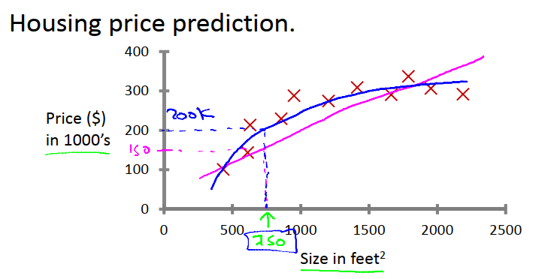
Difference between Regression and Classification
Regression is prediction of continuous value.

Slide 3
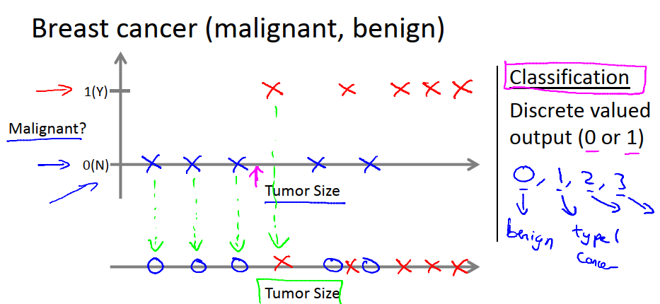
Difference between Regression and Classification (Cont’d)
Classification is the process of classifying the existing data.

Slide 4
Regression or Classification?
Scenario 01
Given a picture of Male/Female, We have to predict Whether He/She is of High school.
Scenario 02
Given a picture of Male/Female, We have to predict his/her age on the basis of given picture.
Scenario 03
Banks have to decide whether or not to give a loan to someone on the basis of his credit history.

Slide 5
Another problem outside the box
9 marble problem.

Slide 6
One variable Linear Regression
Dataset
Setting Parameter
Hypothesis Function
Cost Function
Gradient Descent
When should we stop?

Slide 7
Dataset
input x | output y
0 | 4
1 | 7
2 | 7
3 | 8

Slide 8
Setting Parameter

Slide 9
Hypothesis Function

Slide 10
Cost Function

Slide 11
Gradient Descent
Problem implementing Gradient Descent(!!)

Slide 12
When should we stop?

Slide 13
To know more and see more…
https://www.youtube.com/watch?v=WnqQrPNYz5Q

Slide 15
Thank You!
You have stepped into the land of Recognizing Pattern!
How far could you go?

